Slide 1
Rutland Elementary Parent Advisory Council

Slide 2



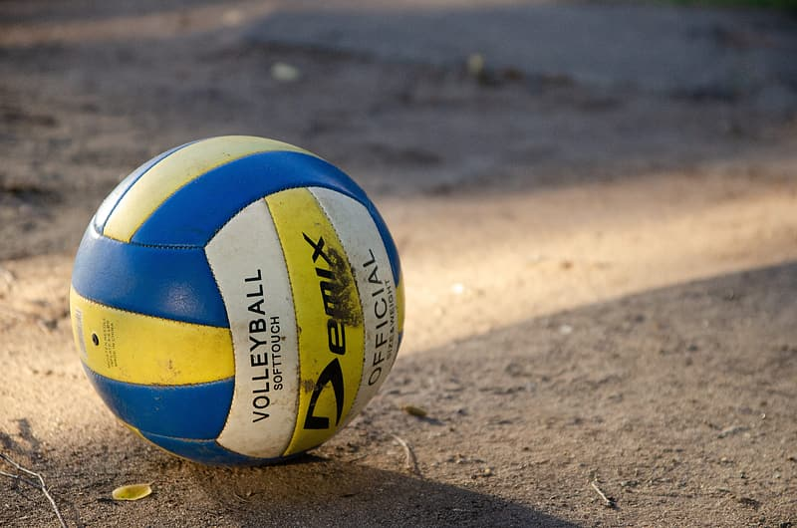
Current Executive
Kaylyn Martin
Jenn Elder
Jen Gelz
Jason Elder + Tamara Pals
President
Vice-President
Secretary
Co-Treasurers

Slide 3
Function of the PAC
We are here to advocate and support students, raise funds for extra activities or things that may not be funded through the school, put on school events to build community and cohesiveness within the parent and student body.
Every parent/guardian is a member of the PAC.
For more information please visit: http://bccpac.bc.ca/index.php/members/pac-dpac/what-is-a-pac

Slide 4
What Does the PAC Do for the School and Students?
The PAC conducts various fundraisers to raise monies to support field trip funding, student resources, library resources, parent education and more!
The PAC has also committed to providing fun family events to bring our school community together.
Past activities and resources funded by the PAC include:
Welcome BBQ and Family Fun Fair
Annual Primary Play Day
Playground upgrade + Gaga Ball Pit installation
Purchasing ORPH instruments for the primary music program
STEAM kits for grades 4 and 5
Sunshine for families who are going through a difficult time
An annual staff appreciation to say thank you to our teachers and staff, and more.
The PAC also provides weekly hot lunch to students.

Slide 5
How Can You Help Out?
Join our monthly PAC Meetings! Meetings are around 1 hour each month. Currently meetings are held via Zoom at 7pm on the 3rd Thursday of each month (subject to change next year)
Volunteer! We are always looking for help with fundraisers, hot lunch, fruit and veggie program and yearbook!
Other times we are looking for volunteers to help with Family Fun Days, or other smaller roles!
Take an active role in your child’s school experience by having your voice heard within our PAC!

Slide 6
June PAC Meeting and AGM
Consider joining us for our June PAC Meeting to hear a summary of this past year’s PAC activities and learn a bit about the direction we are taking next year!
Thursday June 16th at 7pm via Zoom.
https://sd23.zoom.us/j/63690970732

Slide 7
Find us on Facebook!
We have a very active PAC Facebook group!
https://www.facebook.com/groups/195387885847447
To join you MUST answer the 2 membership questions!
(Child’s teacher’s name and Child’s Grade)

